Slide 1




Web Storage and Cookies
Cookies, Local and Session Storage
SoftUni Team
Technical Trainers
Software University
http://softuni.bg

Slide 2


Table of Contents
Cookies: Overview, Structure, Usage
Web Storages
Session Storage
Local Storage
Saving objects in Web Storages
Storage Events
Cookies vs. Web Storages

Slide 3

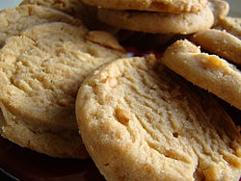
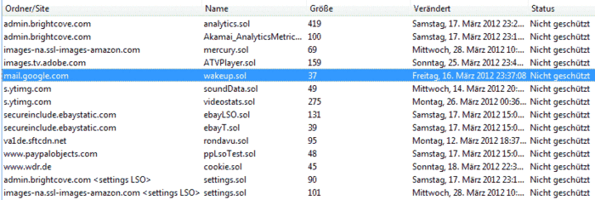
HTTP Cookies
How the Cookies Work?

Slide 4

What are Cookies?
Cookies are small pieces of data in the Web browser
Sent by the Web server (Web application)
Stored inside the user's Web browser
At each request the browser sends the cookies to the server
Cookies can store only plain text
The size of the cookies can be up to 4KB
Cookies can be read / set by JavaScript
HTTP
cookie

Slide 5
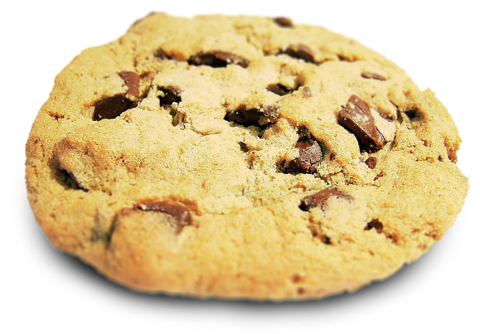


What are not Cookies?
Cookies do not authenticate a user
Cookies give a unique identifier to differentiate one user from another
!=
!=

Slide 6


Cookie – How It Works?
1. HTTP Request
2. HTTP Response + Set cookie
3. HTTP Request + cookie
4. HTTP Response
Web Client
Web Server

Slide 7
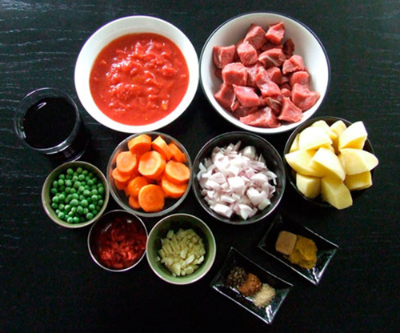
Cookies: Structure
A cookie consists of several parts
A name-value pair that holds the cookie information
The name is used to reach the data stored in the value
The expire date of the cookie
Used to set timeframe for the cookie work
A cookie without an expiration date is removed on browser close event
Path at the server the cookie is good for
Domain the cookie is good for

Slide 8
Cookies: Usage
Cookies save some state of the user preferences in the browser
Authenticated to the server once, remember your login
E.g. you login at some site a click "Remember Me"
If someone steals the cookie, he takes your saved credentials
Cookies are sent with the headers of all HTTP requests to the matching server
Cookies keep track of your movements within the site
E.g. remember the theme selection and other preferences

Slide 9
Working with Cookies from JS
Cookies can be accessed from JavaScript
Use document.cookie property
Cookies are not strings, they are read as strings
JavaScript doesn’t have good API to easily work with cookies
document.cookie = 'c1=cookie1; expires=Thu, 30 Apr 2013 21:44:00 UTC; path=/'
document.cookie = 'c2=cookie2; expires=Tue, 29 Apr 2013 11:11:11 UTC; path=/'
console.log(document.cookie);

Slide 10
Creating Cookies
function setCookie(name, value, expires, path, domain) {
var cookie = name + '=' + escape(value) + ';';
if (expires) {
if(expires instanceof Date) {
expires = new Date();
} else {
expires = new Date(new Date().getTime() +
parseInt(expires) * 1000 * 60 * 60 * 24);
}
cookie += 'expires=' + expires.toGMTString() + ';';
}
if (path) { cookie += 'path=' + path + ';'; }
if (domain) { cookie += 'domain=' + domain + ';'; }
document.cookie = cookie;
}

Slide 11
Reading Cookies
function readCookie(name) {
var nameEQ = name + '=';
var allCookies = document.cookie.split(';');
for(var i = 0; i < allCookies.length; i += 1) {
var cookie = allCookies[i];
while (cookie.charAt(0) == ' ') {
cookie = cookie.substring(1, cookie.length);
}
if (cookie.indexOf(nameEQ) == 0) {
return cookie.substring(nameEQ.length, cookie.length);
}
}
return null;
}

Slide 12
Deleting Cookies
You can delete a cookie by
Adding a new empty cookie with the same name and expire date
function deleteCookie(name) {
if(getCookie(name)) {
createCookie(name, '', -1);
}
}

Slide 13
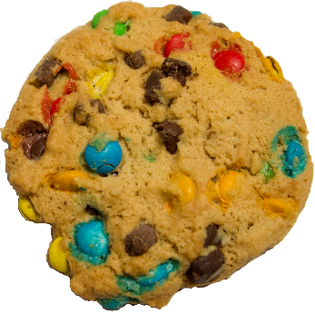


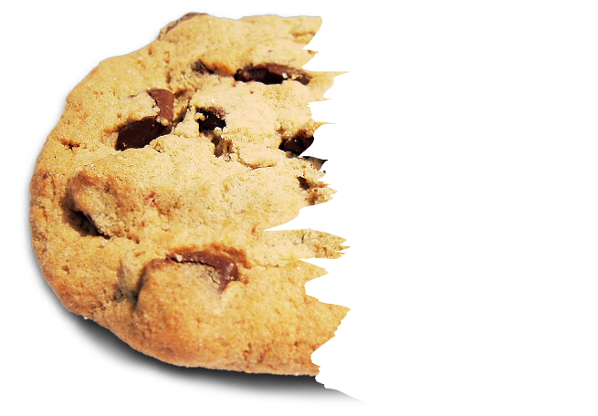
Cookies
Live Demo

Slide 14



Web Storages
Cookies, Local and Session

Slide 15
What is Web Storage?
Methods and protocols used for storing data in a Web browser
Web storages are improved cookies
Provide a set of key-value pairs
Limited to 5MB capacity in most browsers
Not automatically sent to the server at each HTTP request
Web servers can't directly write to the Web storage
Supported down to IE8 (needs shims for IE7)

Slide 16
Web Storage: How It Works?
1. HTTP Request
2. HTTP Response
3. Set data to Web storage via JS
Web Client
Web Server

Slide 17
Web Storages
Web Storages are store data in a user's Web browser
Save a user's settings, so next time the user opens the application, they can be loaded
Two common types of Web Storages
Local Storage
Accessible only from a single document
Session Storage
Accessible only while the document is open
Difference between local and session storage: lifetime and scope
Web storages are part of the HTML5 specification

Slide 18
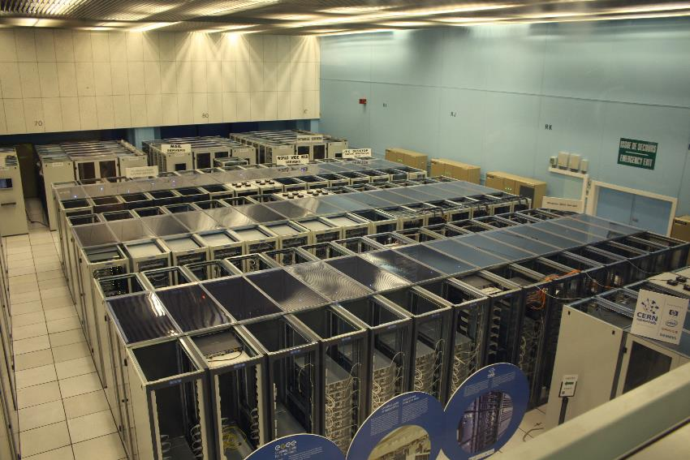
Local Storage
Storing Local Data in the Web Browser

Slide 19
Local Storage: How It Works?
Accessible through
document.localStorage
Similar to cookies
Data stored through localStorage is permanent
Closing a browser or a tab does not clear the local storage data
It does not expire and remains stored on the user's PC for long
Can store only strings

Slide 20
Local Storage – Example
Accessing the local storage
The same as:
// Save data in the local storage
localStorage[key] = data;
// Read data from the local storage
var data = localStorage[key];
localStorage.setValue(key, data);
var data = localStorage.getValue(key);

Slide 21
Local Storage
Live Demo

Slide 22
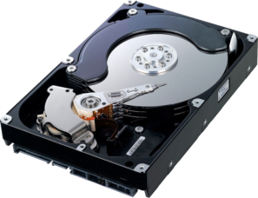

Session Storage
Temporary Hold Data in the Browser Session

Slide 23
Session Storage: How It Works?
The global object sessionStorage maintains storage area, available for the duration of the page session
Accessible through document.sessionStorage
Similar to local storage, but keeps data only for the session
Can store only strings
Opening a page in a new window or a tab starts a new session
Deleted when the window / tab is closed
Great for sensitive data (e.g. banking sessions)

Slide 24
Session Storage – Example
function incrementLoads() {
if (!sessionStorage.counter) {
sessionStorage.setItem('counter', 0);
}
var currentCount = parseInt(sessionStorage.getItem('counter'));
currentCount += 1;
sessionStorage.setItem('counter', currentCount);
document.getElementById('countDiv').innerHTML = currentCount;
}

Slide 25
Session Storage
Live Demo

Slide 26
Saving Objects in Web Storages as JSON
Local and session storages can only contain strings
Saving objects, invokes its toString() method
To save objects into web storages, extend the Storage prototype
Storage.prototype.setObject = function setObject(key, obj) {
this.setItem(key, JSON.stringify(obj));
};
Storage.prototype.getObject = function getObject(key) {
return JSON.parse(this.getItem(key));
};

Slide 27

Saving Object in WebStorages
Live Demo

Slide 28


Storage Event
on storage
function evHandler(ev) {
// do something
console.dir(ev);
}
Web Client
Web Storage
Live Demo

Slide 29

Cookies vs. Local Storage

Slide 30


Cookies vs. Local Storage
Cookies
Legacy support
Persistent data
Expiration date
Access server or client-side
Sent with every request
Can store only 4KB
Harder to work with
Local Storage
Not supported everywhere
Persistent data
No expiration date (data is saved permanently)
Access only client-side
Is not sent with every request
Can store 5MB
Applied same-origin rules

Slide 31

Cookies vs Local Storage - Conclusion
For saving client-side data, the local storage wins
If your server needs information from a client, cookies will be a better solution
If you want to save some user preferences, choose local storage

Slide 32


Summary
Cookies – small data, sent on every request
document.cookie
Web Storages – storing data in a web browser
Session Storage – stores data only for session
sessionStorage.setItem/getItem
Local Storage – stores data permanently
localStorage.setItem/getItem
Storage Event
on('storage', handler);
Use local storage when you don’t need data on the server
JS Apps

Slide 33







Web Storage and Cookies
https://softuni.bg/courses/javascript-applications/

Slide 34
License
This course (slides, examples, demos, videos, homework, etc.) is licensed under the "Creative Commons Attribution-NonCommercial-ShareAlike 4.0 International" license
Attribution: this work may contain portions from
"JavaScript Applications" course by Telerik Academy under CC-BY-NC-SA license

Slide 35




Free Trainings @ Software University
Software University Foundation – softuni.org
Software University – High-Quality Education, Profession and Job for Software Developers
softuni.bg
Software University @ Facebook
facebook.com/SoftwareUniversity
Software University @ YouTube
youtube.com/SoftwareUniversity
Software University Forums – forum.softuni.bg

